Slide 1

Basic Details of the Team and Problem Statement
Organization Name/Student Innovation: Ministry of Defence
PS Code: SIH1414
Problem Statement Title: Metal detection using drone
Team Name: Doorlock
Team Leader Name: Karthick raja V
Institute Code (AISHE): C-16576
Institute Name: Chennai Institute of Technology
Theme Name: Miscellaneous

Slide 2
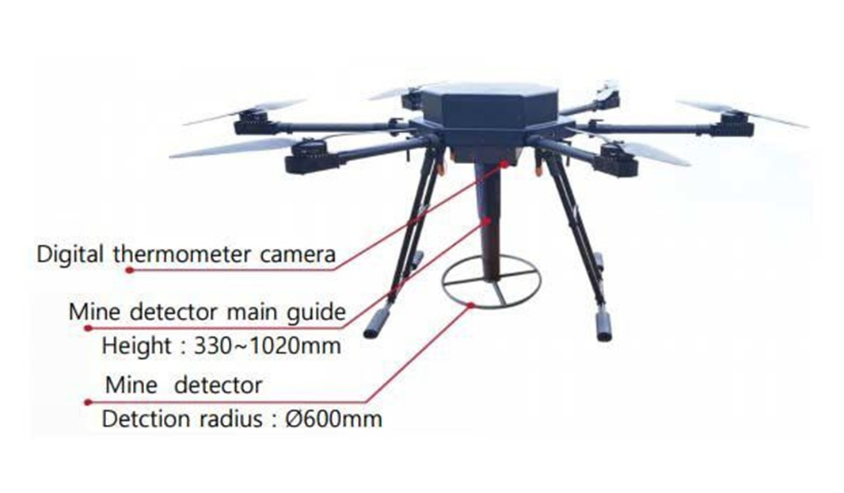
Idea/Approach Details
SOLUTION
PROBLEM STATEMENT: Drone based Intelligent Magnetic sensing systemand Metallic anomalydetection system
SOLUTION:
The system comprises a custom drone equipped with a metal detection sensor and a high-resolution camera. The drone collects data while flying over an area.
Metal Detection Sensor: This sensor detects metals in the ground and records their electromagnetic properties.
High-Resolution Camera: Captures images of the terrain.Onboard Machine Learning Model: Classifies detected metals based on their electromagnetic signatures.
Data Logging: Stores collected data.
Ground Station Interface: Displays real-time information to users, including flight path and metal classifications.
Metal Type Classification Results: Shows the results of metal classification . This system combines drones, sensors, machine learning, and a user interface to detect and classify metals in various applications.
TECHNOLOGY STACK
TOOLS AND TECHNOLOGIES:
1.Magnetic sensors
2.Data logging
3.Data fusion
4.User Interface
5.Data Visualization and Reporting
PLATFORM:
Mission planner
DJI Flight Simulator
2

Slide 3
USE CASES
Archaeology and Historical Preservation: Identify and classify buried artifacts made of different metals, aiding archaeologists in preserving and studying historical sites with precision.
Geological Exploration and Mining: Locate valuable ore deposits and determine the types of metals present in geological formations, assisting mining companies in resource assessment.
Construction and Utilities: Detect and assess underground infrastructure, such as pipes and cables, to prevent damage during excavation and construction activities.
Security and Threat Detection: Enhance security by detecting hidden metal objects in security-sensitive areas, improving safety and threat detection in airports, public events, and government facilities.
Environmental Studies: Identify and analyze metal contamination in soil and water, aiding environmental researchers in assessing and mitigating pollution.
Customs and Border Control: Strengthen border control efforts by detecting contraband or smuggled goods made of different metals, reducing illegal trafficking
SHOW STOPPERS
Environmental Factors: Environmental conditions, such as changes in temperature, humidity, and wind, can affect the flight stability and sensor performance of drones. Adverse weather conditions may restrict the use of drones for data collection.
Calibration and Data Accuracy: Achieving accurate and consistent calibration of magnetometers is critical. Changes in temperature, sensor orientation, and other factors can affect the accuracy of measurements.
Limited Penetration Depth: Magnetic fields weaken rapidly with distance, which limits the penetration depth of magnetometers. This means that detecting deep anomalies can be challenging, and the technology may not be suitable for certain applications requiring deep subsurface exploration.
3

Slide 4
Team Member Details
Team Leader Name: Karthick raja V Branch: B.E Team Member 1 Name: Vishvasen B Branch : B.E Team Member 2 Name: Srinath S A Branch : B.E |  | Stream : ECE Stream : ECE Stream : ECE | Year : III Year : III Year : III
Team Member 3 Name: Shujitha Rani A Branch : B.E Team Member 4 Name: Raja Rajeshwari J |  | Stream : ECE | Year : III
Branch : B.E Team Member 5 Name: Sujithram A G Branch : B.E Team Mentor 1 Name: Category: Team Mentor 2 Name: |  | Stream : ECE Stream : MECH Expertise: | Year : III Year : III Domain Experience:
Category: |  | Expertise: | Domain Experience:

